Slide 1
A warm welcome to our guide to Dry Sandford Primary School…
We hope this leaflet will give you a good insight into our vibrant, happy and successful school. But don’t just take our word for it, our latest OFSTED report has many insights into what’s special about our school community.
Staff are experienced, caring and most importantly committed to meeting the individual needs of every child, all within a secure and happy environment.
“An aspirational culture in which pupils are keen to excel”
“A rich and broad curriculum, with a wide variety of high-quality enrichment experiences”
“A clear focus on achieving the highest quality of teaching and learning”
“Staff know each pupil particularly well, their individual needs & adapt to ensure learning is appropriately pitched”
“Pupils are articulate, confident & display very positive attitudes towards learning, their school and each other”
“A particularly nurturing and inclusive community atmosphere”
“All groups of pupils, including disadvantaged pupils and those with SEND, make strong progress across the school”
Source: OFSTED Inspection comments

Slide 2
Your child’s learning journey will be much more than just the core curriculum…
We have an obvious focus on the core skills of reading, writing and mathematics; but, we are also broadening the curriculum around science and humanities. In addition, our teaching also promotes reasoning skills, deeper thinking and reflection. The ultimate objective is to help our children develop into kind, confident and well rounded individuals that understand and are proud of their own achievements.
Early Years
Key Stage 1
Key Stage 2
High quality provision
Well-planned & stimulating learning opportunities
Well prepared for Key Stage 1
Use of Forest School learning, with 2 qualified practitioners
Differentiated phonics provision
ensures excellent progress
Development of maths mastery of
foundation skills
Developing resilience throughout
an exciting curriculum
Children building on foundation skills
to become confident, responsible
learners who are ready for their next
steps at secondary school
Rich and broad learning experiences
with high quality enrichment
Children strive to reach their full
potential in all areas of learning

Slide 3
Forest School is a critical component of your child’s learning at Dry Sandford… and we’re investing heavily in new facilities.
We already have an established Forest School practice at Dry Sandford – but we have also secured a £10,000 investment for March 2018 to further springboard our outdoor learning. This is a wonderful opportunity to extend our activities further.
Forest School
Development Plans

Slide 4
Our latest Key Stage 2 results illustrate…
That we are an ‘improving’ school, with combined SATs results 8% above the national average and, at an individual subject level significantly higher in Maths, SPAG (spelling, punctuation and grammar) and Reading.
Summary:
Significant improvement in Maths, SPAG and Reading compared to 2016, but improvements in all areas.
Guide:
Dry Sandford’s results in orange (2016) and green (2017) bars.
National averages (2016 and 2017) as dotted lines.
* SPAG = Spelling, Punctuation & Grammar; ** Writing = Assessed internally at school;
† Combined = Achieved ‘Expected or Above’ in all tests

Slide 5
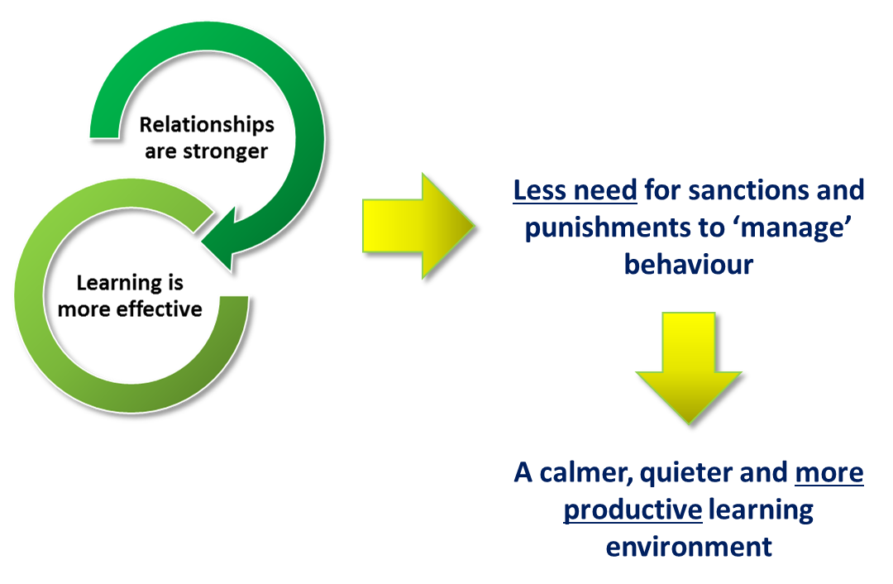
Dry Sandford Primary School was an early innovator in the use of our ‘Restorative Approach’ to manage behaviours in school.
What is the ‘Restorative Approach’ and how can it help children’s behaviours?
The key benefits of a restorative approach is that it offers schools an alternative way of thinking about addressing discipline and behavioural issues; and, offers a consistent framework for responding to these issues. However, the approach is much more than a ‘behaviour management tool’.
A Restorative Approach
“We are better at opening up our feelings if something has gone wrong”

